Slide 1
Contours

Slide 2
Issues with edges
Edges have no identity
Edges have no continuity properties.
Edges cannot be easily counted and worked upon
Edges cannot be differentiated from one another
Edges in themselves have no defined shape

Slide 3
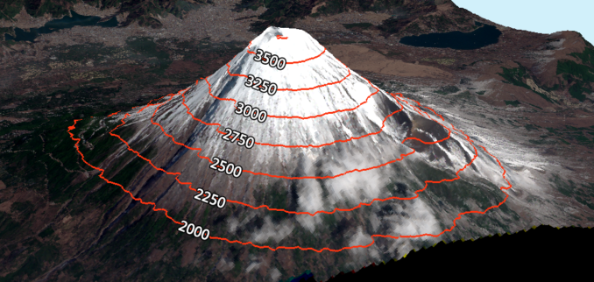
Contours
Are an outline representing or bounding the shape or form of something.
Credits: https://gisgeography.com/contour-lines-topographic-map/

Slide 4
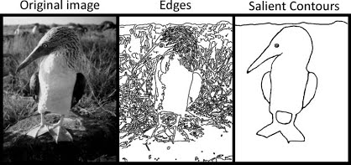
Contours in image processing
Are designed using edges
They are edges with an identity, geometrical parameters and are continuous
They are useful for shape analysis and object recognition
Credits: https://sites.google.com/site/vonikakis/research

Slide 5
Colab - Contour Demo

Slide 6
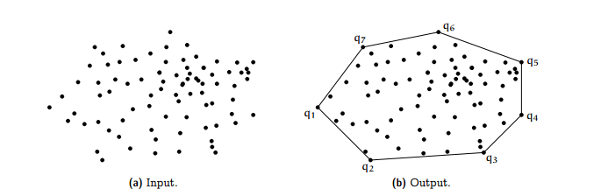
Convex Hull
The convex hull or convex envelope or convex closure of a set X of points in the Euclidean plane or in a Euclidean space (or, more generally, in an affine space over the reals) is the smallest convex set that contains X.
Credits: https://medium.com/@harshitsikchi/convex-hulls-explained-baab662c4e94

Slide 7
Colab - Convex Hull Demo

Slide 8
Advanced Image Enhancement

Slide 9
Need for Image Enhancement
Improve the interpretability or perception of information
Provide `better' input for other automated image processing techniques.
Image enhancement techniques can be divided into two broad categories:
Spatial domain methods, which operate directly on pixels
frequency domain methods, which operate on the Fourier transform of an image.

Slide 10
Colab - Enhancement Demo

Slide 11
Multi-Resolution Image Processing

Slide 12
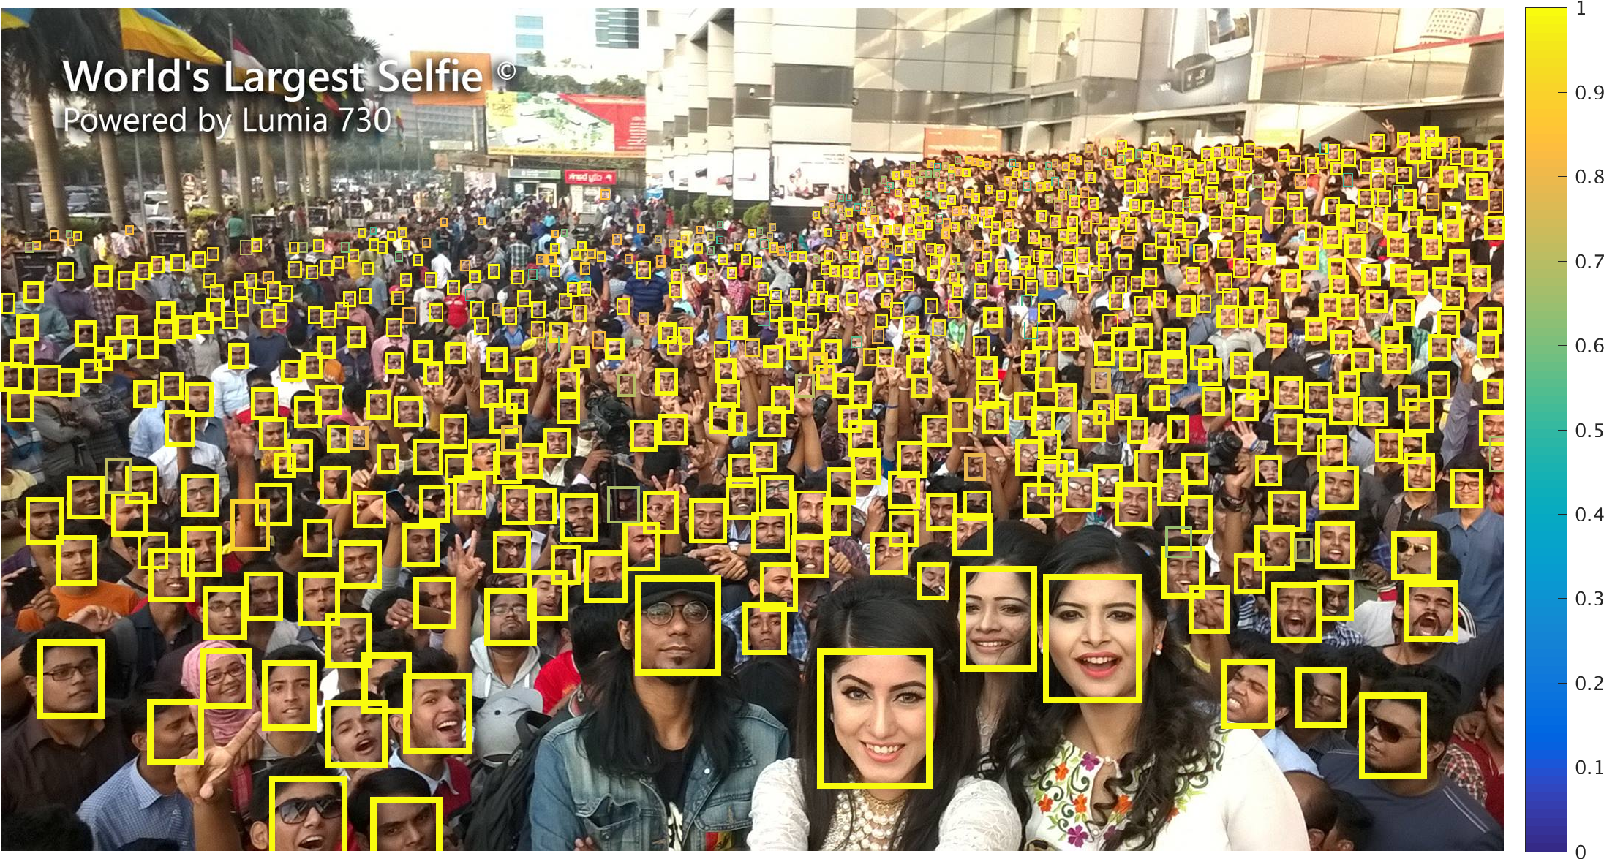
Detecting similar object with varying sizes
Credits: https://www.cs.cmu.edu/~peiyunh/tiny/

Slide 13
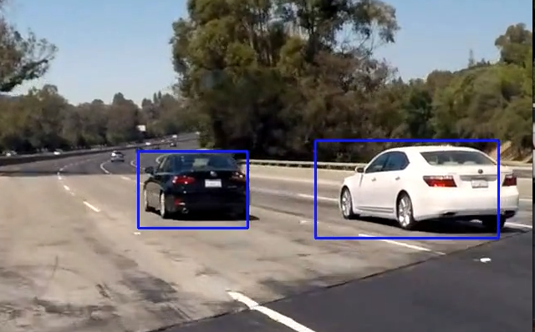

Slide 14
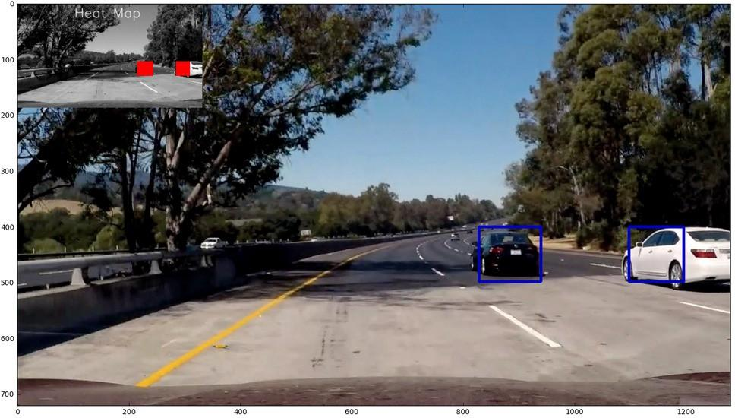

Slide 16
Other Advantages
Scaling down for less storage requirements
Scaling image up for zooming operation
Scaling images and combining them is used for increasing image sharpness

Slide 17
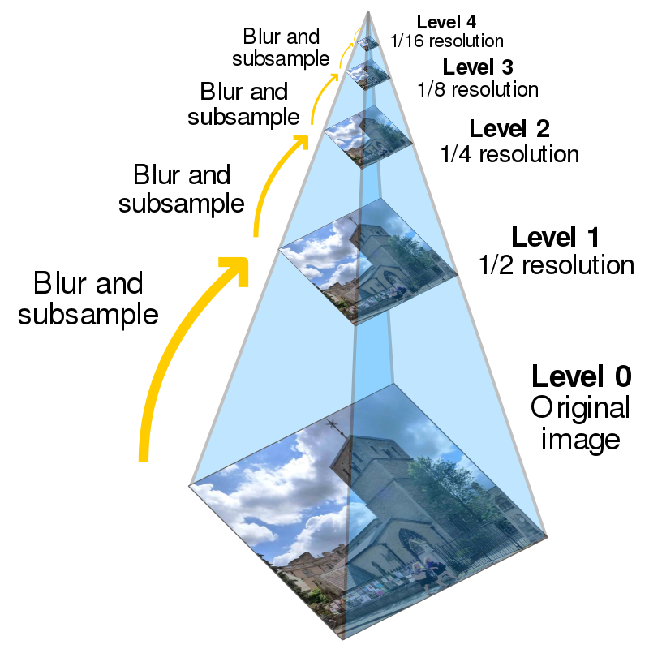
Pyramidal images
This scaling up and down can be visualized as pyramids. Thus the name pyramidal image processing
Credits: https://en.wikipedia.org/wiki/Pyramid_(image_processing)

Slide 18
Colab - Pyramids Demo

Slide 19
Image and Video Compression
By 2020 the digital world is expected to have generated 45 zettabytes of data.
Most of which is images and Videos.
On an average 80% of daily internet data usage of an individual results out of videos and images
Urgent need for lossless data compression techniques
Less data transfer
Less data storage

Slide 20
Popular image compression techniques
Lossless compression:
Run-length encoding used for BMP files
DEFLATE data compression used for PNG files
LZW compression used for GIFs
Lossy compression:
JPEG

Slide 21
Features

Slide 22
What are image features
Features
Describe an image
Point out relevant information in an image
Distinguish a set of images from others
Types
Global: For an image as a whole
Local: For a region inside an image
Formal definition: In computer vision and image processing, a feature is a piece of information which is relevant for solving the computational task related to a certain application.
All the machine learning and deep learning algorithms feed on features.

Slide 23
What can be a feature
Pixel intensity alone cannot be a feature
Features:
Global intensity measures - average, histogram, color palatte etc
Edges and Ridges - gradients, contours, etc
Interest points - Corners, unique curvatures, etc
Blobs and textures
Features from filters
…..

Slide 24



Intensity grouped as a feature

Slide 25
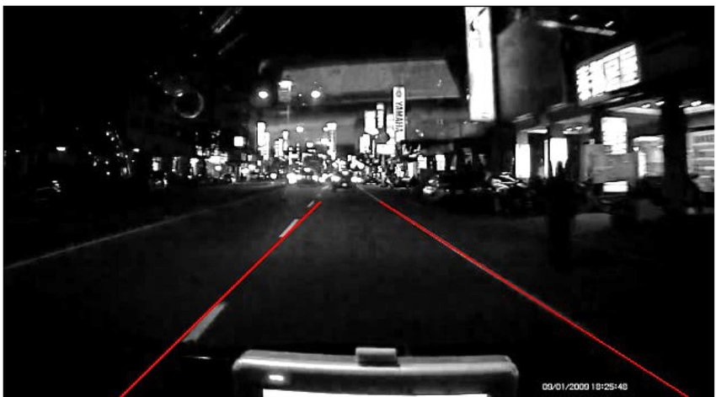
Edges as features
Credits:https://www.researchgate.net/publication/316585570_Lane_departure_warning_system_using_front-view_and_two_mirror-view_cameras/figures?lo=1

Slide 26
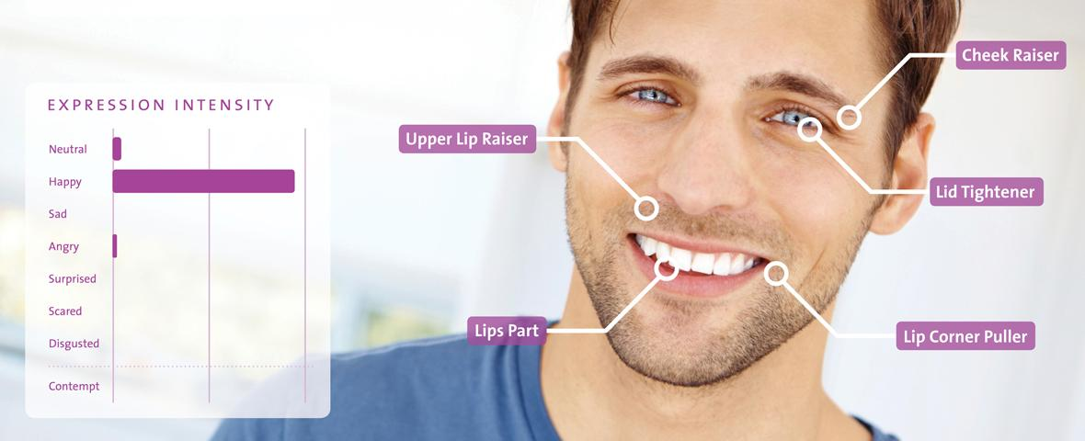
Keypoints as features
Credits: https://www.noldus.com/blog/how-master-automatic-facial-expression-recognition

Slide 27
What are good features
Features are considered good if they are not affected a lot by external factors.
Invariance in features
scale
rotation
translation
perspective
affine
color
illumination

Slide 28
Corners and KeyPoints
Corners - Defined as the intersection of two edges.
Keypoint - a point in an image which has a well-defined position and can be robustly detected
Used in:
motion detection and video tracking
image registration
image mosaicing and panorama stitching
3D modelling and object recognition.

Slide 29
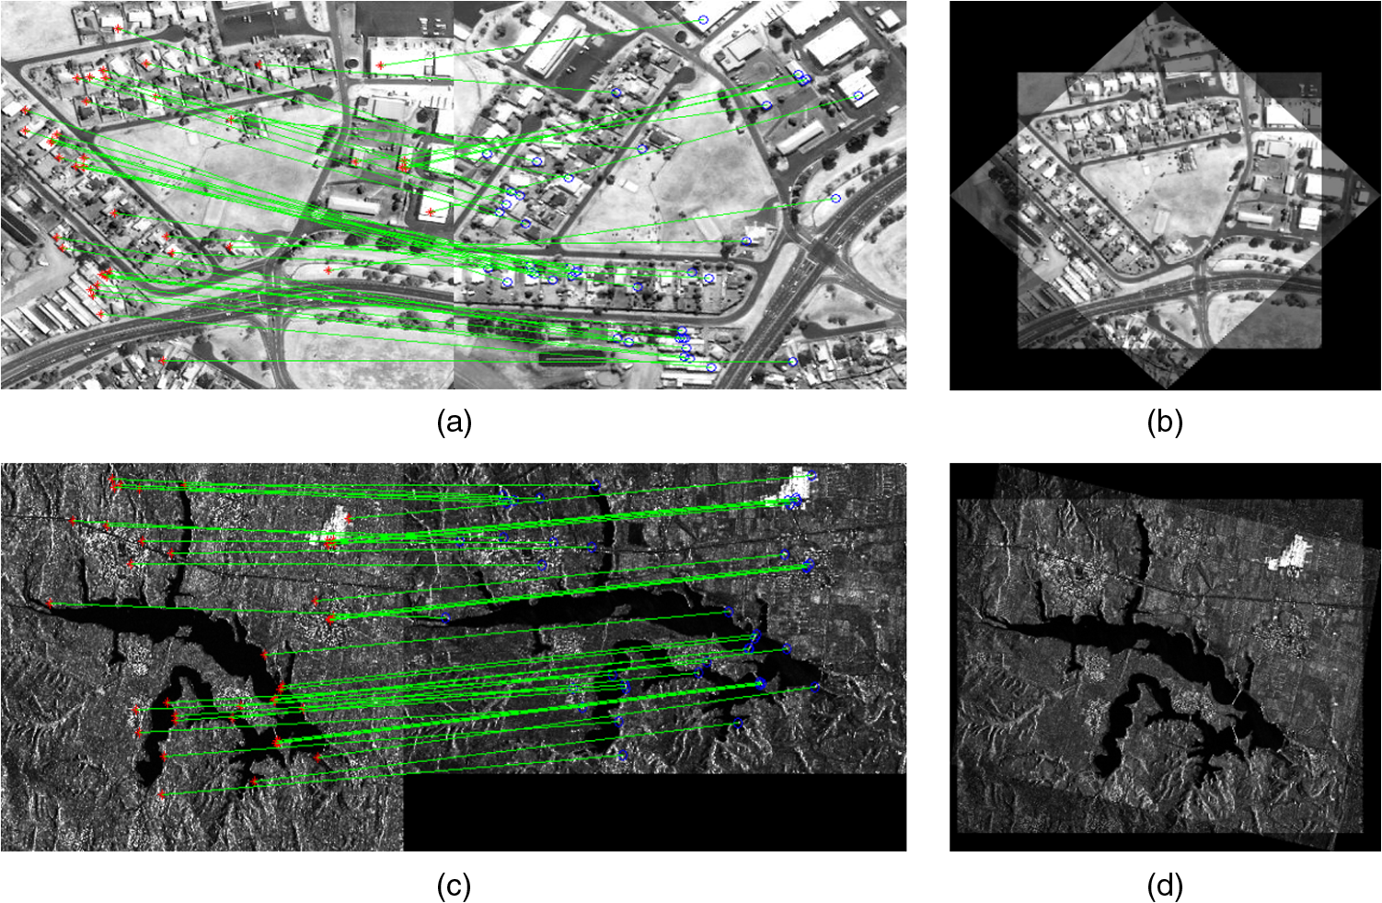
Image Registration and Keypoints
Credits:
https://www.spiedigitallibrary.org/journals/Journal-of-Applied-Remote-Sensing/volume-10/issue-2/025014/Robust-image-registration-using-adaptive-coherent-point-drift-method/10.1117/1.JRS.10.025014.short?SSO=1

Slide 30
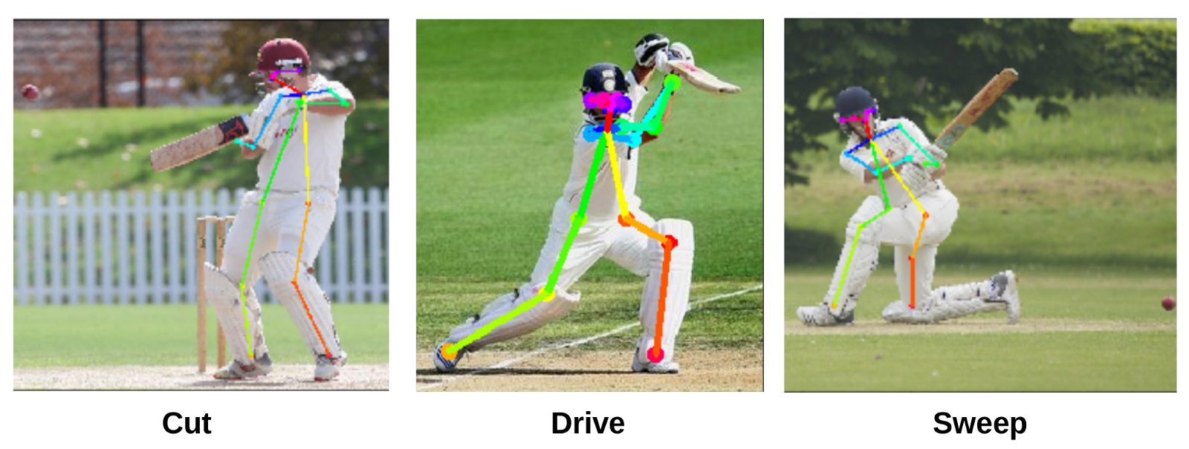
Credits: https://towardsdatascience.com/can-we-generate-automatic-cricket-commentary-using-neural-networks-dbed3aeeef07

Slide 31
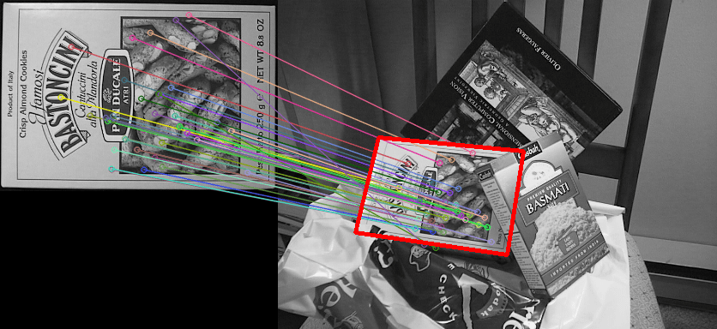
Credits: https://www.researchgate.net/publication/328991586_Image_Feature_Matching_and_Object_Detection_Using_Brute-Force_Matchers/figures?lo=1

Slide 32
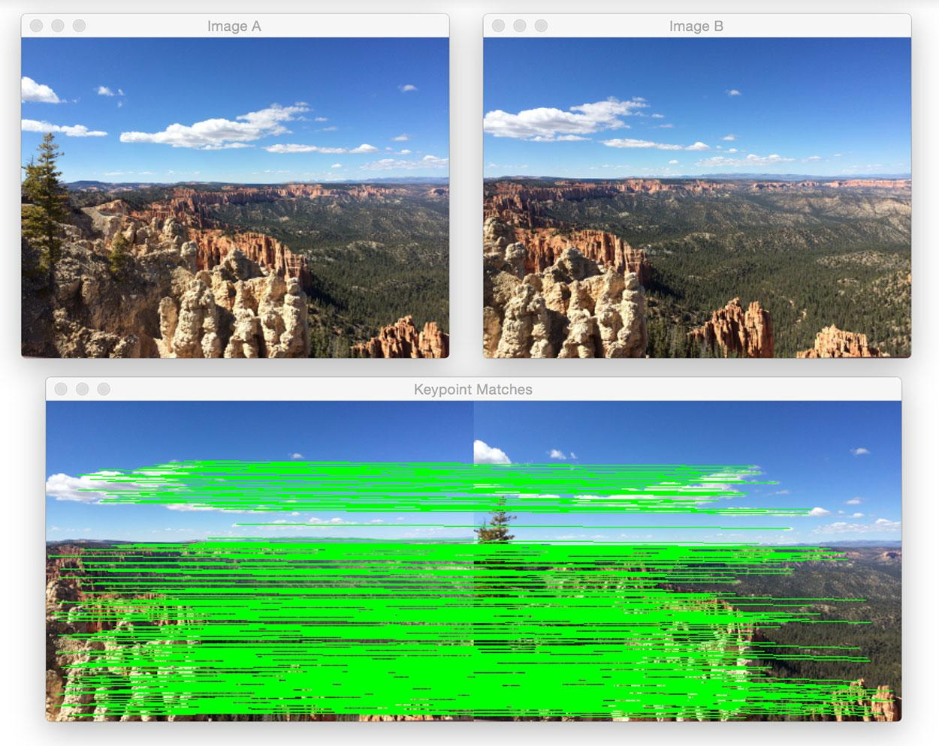
Credits: https://www.researchgate.net/publication/328991586_Image_Feature_Matching_and_Object_Detection_Using_Brute-Force_Matchers/figures?lo=1

Slide 33
Harris Corner
First introduced by Chris Harris and Mike Stephens in 1988
Harris corner detector algorithm can be divided into five steps.
Color to grayscale
Spatial derivative calculation
Structure tensor setup
Harris response calculation
Non-maximum suppression
Notes:
Steps: https://en.wikipedia.org/wiki/Harris_Corner_Detector

Slide 34
Colab - Harris Corner Demo

Slide 35
Shi-Tomasi Corners
The Harris corner detector has a corner selection criteria.
A score is calculated for each pixel, and if the score is above a certain value, the pixel is marked as a corner.
Shi and Tomasi suggested that the function should be done away with. Only the eigenvalues should be used to check if the pixel was a corner or not.
These corners are exactly like harris corners with a minor upgrade.

Slide 36
Colab - Shi tomasi Corner Demo

Slide 37
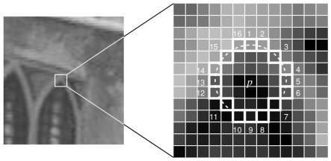
OpenCV Fast corner
Select a pixel, let its Intensity be i
Select threshold value t
Consider a circle of 16 pixels around the pixel
Now the pixel p is a corner if there exists a set of n contiguous pixels in the circle (of 16 pixels) which are all brighter than i + t, or all darker than i − t.

Slide 38
Colab - Fast features Demo

Slide 39
HoG features
Histogram of Gradients
Used for Object Detection
Steps:
Find gradients in both x and y directions
Bin gradients into a histogram using the gradient magnitude and direction
Link: https://www.learnopencv.com/histogram-of-oriented-gradients/
Hog features are sensitive to rotation of objects in images.
Notes:
Explain using: https://www.learnopencv.com/histogram-of-oriented-gradients/

Slide 40
Colab - Hog Demo

Slide 41
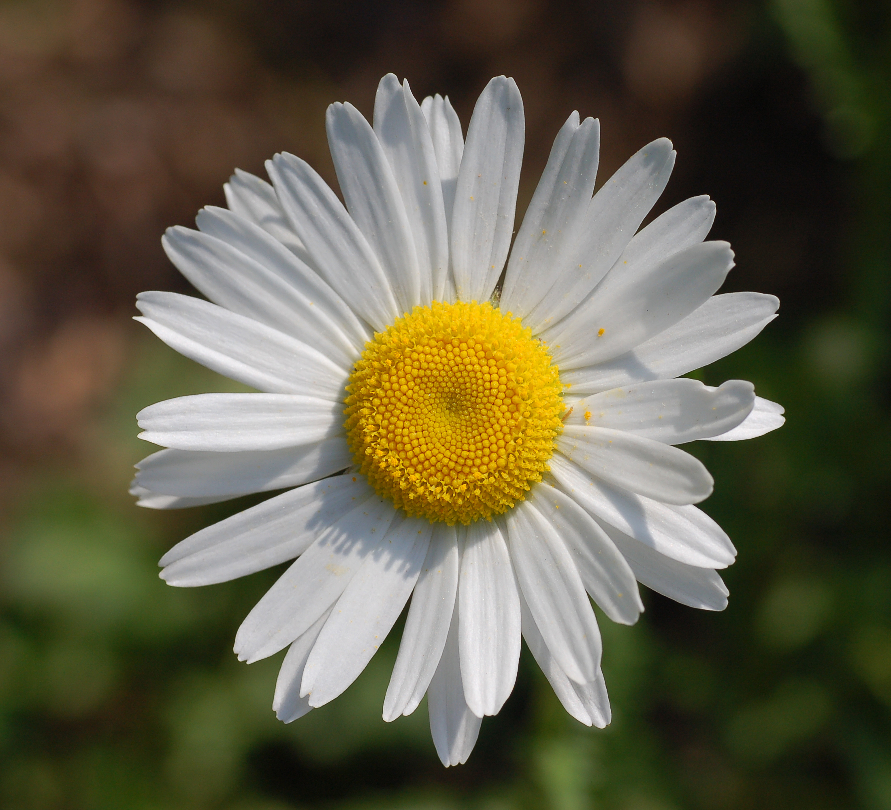
DAISY Features
Upgraded HOG features
Creates a dense feature vector which is not suited for visualization
Process:
T Block -> Calculate gradients or histogram of gradients
S Block -> Combine T-block features using gaussian weighted addition(profiles)
N Block -> Normalize the added features (bring everything between 0-1)
D Block -> Reduce dimensions of features (PCA algorithm)
Q Block -> Compress features for storage purposes (Optional)

Slide 42
Colab - Daisy Demo

Slide 43
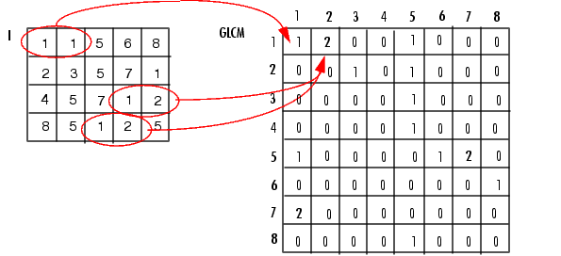
GLCM Features
Gray Level Covariance Matrix
Calculate overall average for degree of correlation between pairs of pixels in different aspects (in terms of homogeneity, uniformity...etc)
Gray-level co-occurrence matrix (GLCM) by calculating how often a pixel with the intensity (gray-level) value i occurs in a specific spatial relationship to a pixel with the value j.

Slide 44
Colab - glcm Demo

Slide 45
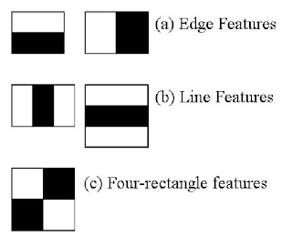
HAAR Features
Used in object recognition.
Rectangular Haar-like features
difference of the sum of pixels of areas inside the rectangle
Each feature is a single value obtained by subtracting sum of pixels under the white rectangle from sum of pixels under the black rectangle.
Credits: https://docs.opencv.org/3.4/db/d28/tutorial_cascade_classifier.html

Slide 46
Colab - Haar Demo

Slide 47
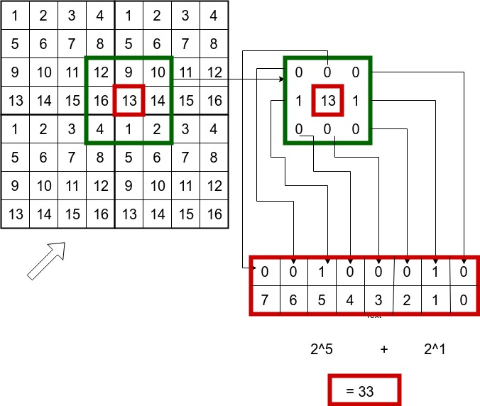
LBP Features
Local Binary Pattern
Elements:
LBP Thresholding
Feature Summation

Slide 48
Colab - Lbp Demo

Slide 49
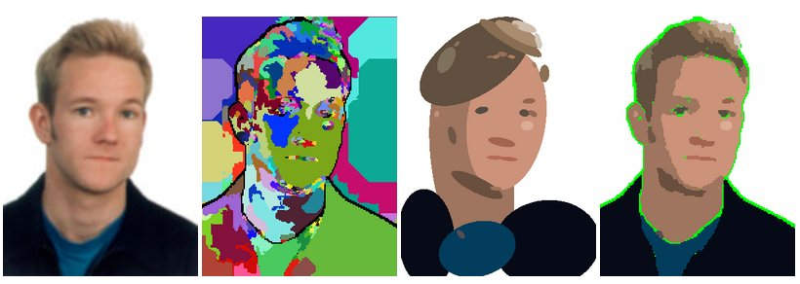
Blobs as features
Blob detection methods are aimed at detecting regions in a digital image that differ in properties, such as brightness or color, compared to surrounding regions.
Informally, a blob is a region of an image in which some properties are constant or approximately constant; all the points in a blob can be considered in some sense to be similar to each other.

Slide 50
Colab - Blob Demo

Slide 51
SIFT Features
Scale Invariant Feature Transform
Patented in Canada by the University of British Columbia
These features are:
Scale invariant
Rotation invariant
Illumination invariant
Viewpoint (Perspective) invariant
One of the most important features in image processing domain
https://towardsdatascience.com/sift-scale-invariant-feature-transform-c7233dc60f37

Slide 52
SIFT Steps
Constructing a scale space - Pyramid generation
LoG Approximation - Laplacian of Gaussian features and gradients
Find key points - maxima and minima in the Difference of Gaussian image
Eliminate bad keypoint
Assign an orientation to the keypoints.
Generate final SIFT features - one more representation is generated for scale and rotation invariance.

Slide 53
Colab - Sift Features

Slide 54
CenSurE features
Center Surround Extremas for Realtime Feature Detection
Outperforms many other keypoint detectors and feature extractors
Link: http://citeseerx.ist.psu.edu/viewdoc/download?doi=10.1.1.465.1117&rep=rep1&type=pdf
These features are:
Scale invariant
Rotation invariant
Illumination invariant
Viewpoint (Perspective) invariant

Slide 55
Colab - CenSure Features

Slide 56
SURF Features
Speeded Up Robust Features
A patented local feature detector and descriptor.
The standard version of SURF is several times faster than SIFT.
SURF uses these algorithms
Integer approximation of the determinant of Hessian blob detector
sum of the Haar wavelet response
multi-resolution pyramid technique
These features are:
Scale invariant
Rotation invariant
Viewpoint invariant

Slide 57
Colab - Surf Demo

Slide 58
BRIEF Features
Binary Robust Independent Elementary Features
Outperforms other fast descriptors such as SURF and SIFT in terms of speed and terms of recognition rate in many cases.
Steps
Image smoothing using gaussian kernels
Converting to Binary feature vector
Does not detect keypoints
Uses the keypoints to develop descriptors on top of them
https://medium.com/@shehan.a.perera/a-comparison-of-sift-surf-and-orb-333d64bcaaea

Slide 59
Colab - Brief Demo

Slide 60
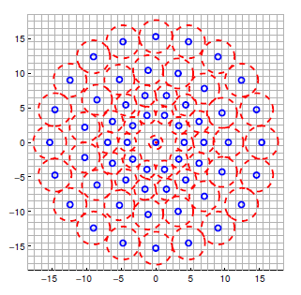
BRISK Features
Credits: https://gilscvblog.com/2013/11/08/a-tutorial-on-binary-descriptors-part-4-the-brisk-descriptor/
Binary Robust Invariant Scalable Keypoints
Composed out of three parts
A sampling pattern: where to sample points in the region around the descriptor. [Image to the right]
Orientation compensation: some mechanism to measure the orientation of the keypoint and rotate it to compensate for rotation changes. Sampling pairs: which pairs to compare when building the final descriptor.

Slide 61
Colab - BRISK Demo

Slide 62
Feature Matching
Done to recognize similar features in multiple images
Used for Object Detection
Methods:
Brute-Force
Matching every feature in image-1 against each feature in image-2
FLANN based matching
Fast Library for Approximate Nearest Neighbors
It contains a collection of algorithms optimized for fast nearest neighbor search in large datasets and for high dimensional features.

Slide 63
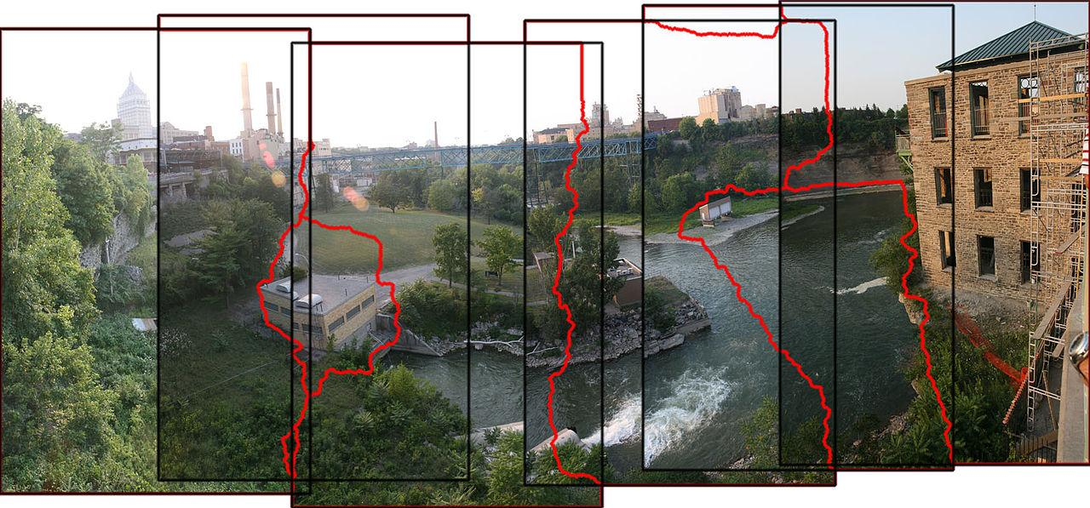
Image Stitching
Image stitching or photo stitching is the process of combining multiple photographic images with overlapping fields of view to produce a segmented panorama or high-resolution image.
Credits: https://en.wikipedia.org/wiki/Image_stitching

Slide 64
Steps in Panorama sub-images
Feature Detection
Feature Matching
Image Homography calculation
Image warping
Stitching

